Slide 1

Big Data Course Introduction

Slide 2

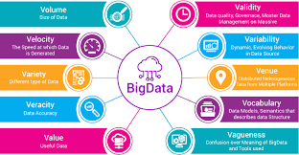
Few Queries on Last Lecture
How do you characterize Big Data?
Source : https://towardsdatascience.com/big-data-analysis-spark-and-hadoop-a11ba591c057

Slide 3
Few Queries on Last Lecture
2. What are the common pitfalls in big data analysis? Justify with suitable examples.
3. Compare and contrast traditional approach and big data analysis with suitable use case.
4.How is error estimation in big data problem is distinct from conventional error estimation?
5. Peter Norvig video

Slide 4

How big data is made possible?
Is it the number of transactions in ATM increased?
Is it the number of email users increased?
Is it emergence of social networking ?
Digitization

Slide 5
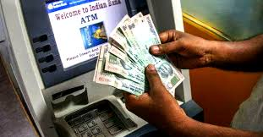
Do we really have changes in the way data got generated?
Way to use data is changed
Enter
Store
Retrieve
Conventional RDBMS
Schema is fixed
Data is clean
Velocity is known
Very less analysis
Source: https://www.thebetterindia.com/191925/rbi-new-rules-atm-transactions-free-debit-card-bank-india/

Slide 6
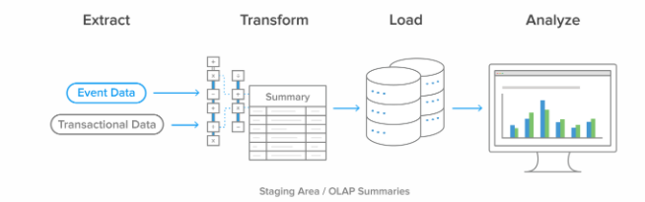
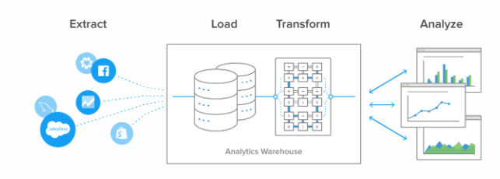
Do we really have changes in the way data got generated?
Way to use data is changed
Once a month report
Not real time ETL
Source :https://www.stitchdata.com/etldatabase/etl-process/

Slide 7


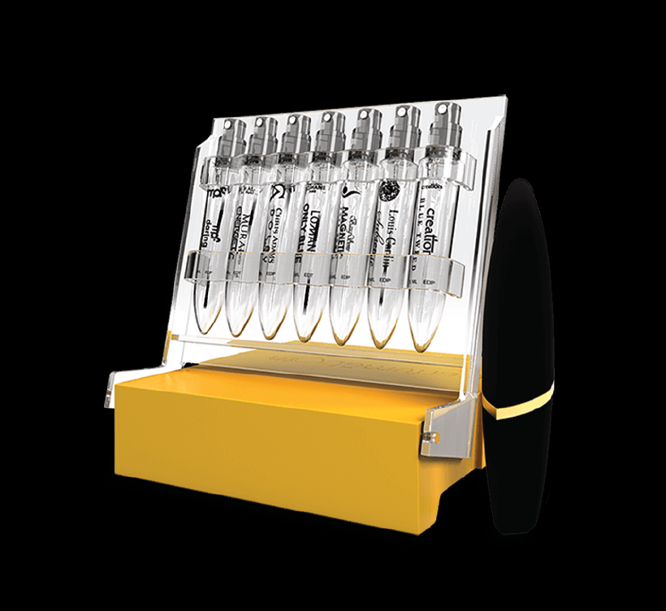
Do we really have changes in the way data got generated?
Way to use data is changed
Now more focus is on personalization

Slide 8

How to do customization?
What She searches?
With whom she is talking?
Where she is going?
Where is she working?

Slide 9
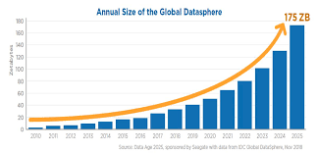
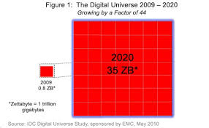
This characterized Big Data Volume
50X growth
Contributed from multiple sources
Source: https://news.softpedia.com/news/Digital-Universe-to-Surpass-1-Zettabyte-in-2010-141272.shtml

Slide 10
Who contributes to this volume?
Automated data from multiple areas
Financial
Communication
Smart homes,cities
Internet
Energy/utilities
Government

Slide 11

Deeper understanding on variety
Bludot
health records,
airline ticketing data,
government notices,
news reports and
disease networks to predict the rise of an illness
Traditional | Big Data
Fixed | Multiple
Integrate multiple sources whose format, type and structure
Text, images, numbers, sequences, time series, arrays etc.
Stream vs static

Slide 12
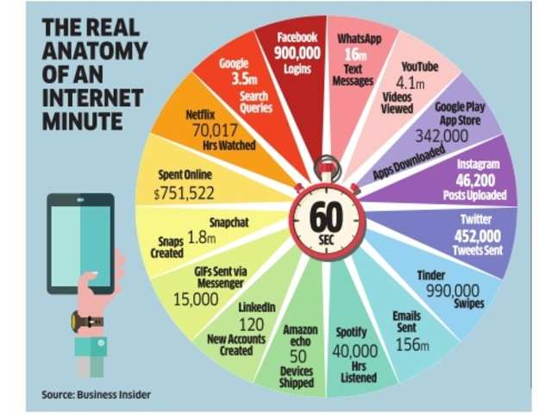
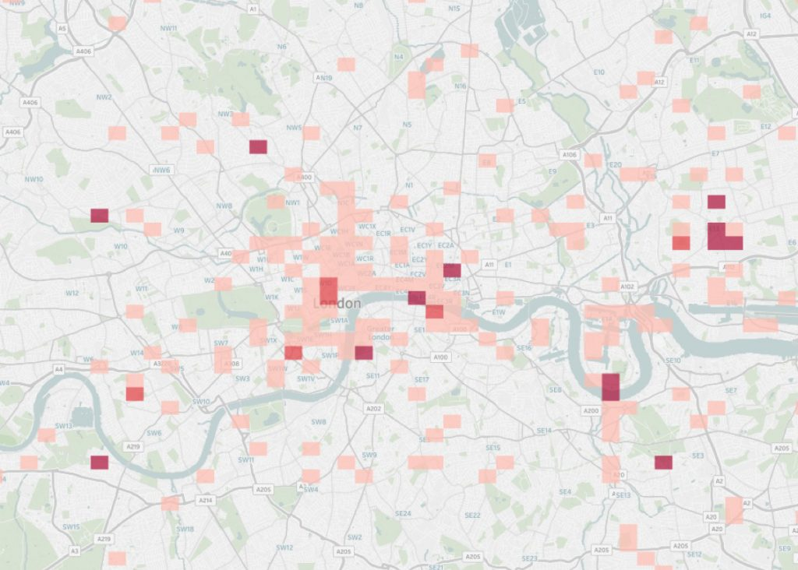
Deeper understanding on velocity
Map network quality across travel routes
https://www.teragence.com/iot-and-connected-cars-concept/#requestademo
https://economictimes.indiatimes.com/small-biz/security-tech/technology/what-happens-in-1-internet-minute/articleshow/60419072.cms

Slide 13


Deeper understanding on veracity
Sudaroli D
Sudaroli Vijay
Messy Data
Sudar
Traditional | Big Data
Clean | Not cleaned Data
Sudaroli

Slide 14
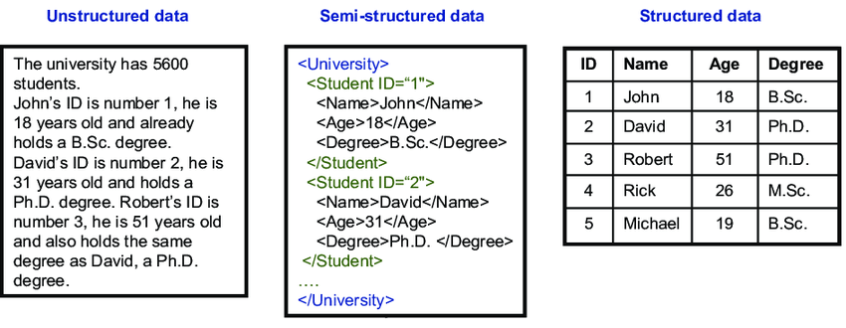
Types of Data/Data Formats
Source :Researchgate.net

Slide 15
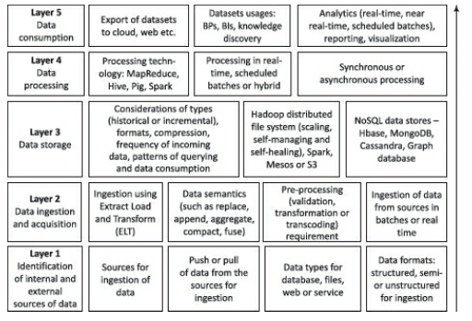
Big Data Architecture Design
Architecture should address all the three forms of data
T1: Fig 1.2 – Logical layers in data processing architecture and their functions.

Slide 16
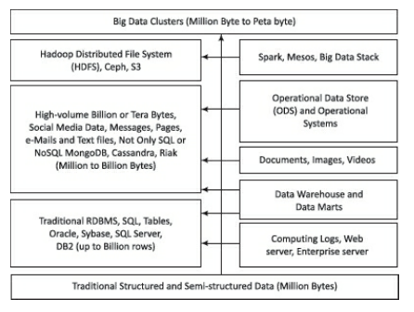
Data Format/Types: Big Data Storage
Data storage for traditional and Big Data
T1: Fig 1.7 – Big data storage plan – RDBMS and NoSQL together

Slide 17
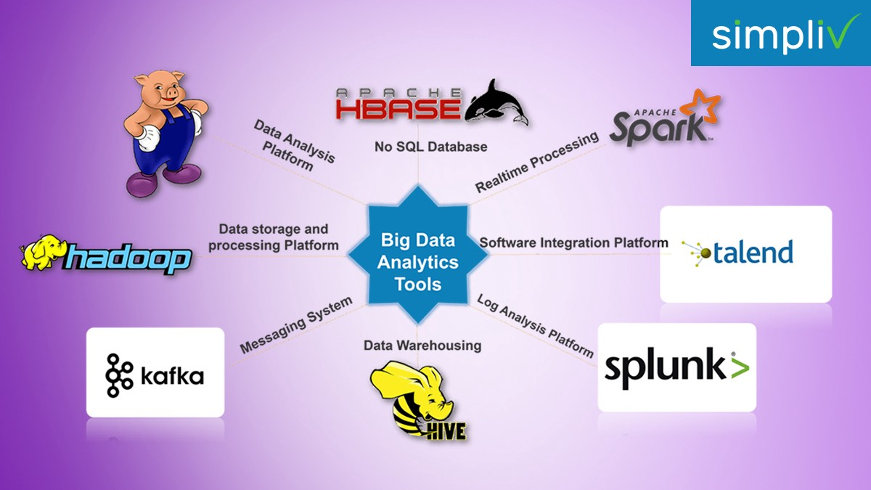
Big Data Platforms
https://medium.com/@satyanageshan8/5-prominent-big-data-analytics-tools-to-learn-in-2019-ee1d4f5b98ce
Notes:
Details of these would be covered in the course – with relevant Hands-on: Hadoop, Kafka, Hive, Spark.

Slide 18

Case Study: How Google Search works?

Slide 19
Case Study: How Google Search works?

Slide 20
Case Study: How Google Search works?
URLServer: sends URLs to crawler
Crawler: sends pages to Store Server
Store Server: compresses and stores in Repository
Indexer: parses page, generates index records containing word, URL, position, font size, capitalization
Also generates link database
Sorter: generates inverted index by sorting on word

Slide 21
THANK YOU

